Slide 1

SENTINEL
Real-Time Healthcare Data Reliability
“The pipeline is green. But is the data healthy?”
Capstone Proposal · Data Engineering
Notes:
Hi everyone, we're Sentinel. Picture a dashboard where everything is green: every service up, every job passing. Our question is simple. The pipeline is green, but is the data healthy?

Slide 2
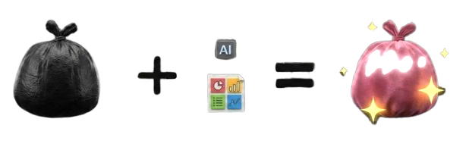
A Green Pipeline Can Still Carry Bad Data
⚠ BAD DATA
● Kafka
UNRELIABLE
DATA
Analytics
● Pipeline
Data Science
● Database
BI
Data Products
NUMBER → STRING
Garbage In, Garbage Out.
1% → 40% null
2,000 → 300/min
INFRASTRUCTURE Is it running? · DATA HEALTH Can we trust it?
Notes:
A pipeline can run perfectly on bad data. Kafka streams it, the pipeline processes it, the database stores it. Garbage in, garbage out. Sometimes something breaks, and data engineers and quality teams have to find what changed, where, and when. The dangerous case is when nothing breaks. Everything stays green while analysts, data scientists, BI and ML teams quietly build on bad data. Infrastructure monitoring asks: is it running? We ask: can we trust the data?

Slide 3

Sentinel Watches the Data, Not Just the Pipeline
SENTINEL · PYTHON DETECTION ENGINE
VALIDATE
PROFILE
COMPARE
DETECT
Incident
Kafka
What changed?
contract
metrics
baseline
rules
Where?
When?
Configurable thresholds + historical baselines
Notes:
Sentinel isn't a black box. It's a Python detection engine reading the Kafka stream. First it validates each FHIR record against the expected contract. Then it profiles the stream in time windows: null rates, volume, distributions. Those measurements are compared with configurable thresholds and historical baselines. When something changes significantly, Sentinel opens an incident: what changed, where, and when. It doesn't claim to know why. It gives engineers a place to start.

Slide 4
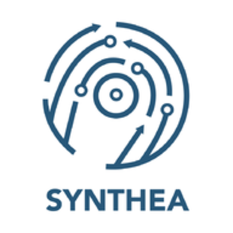




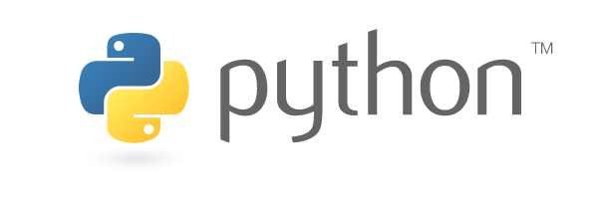

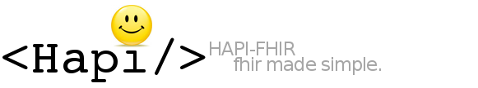

How Do We Test This Without Real Patient Data?
⚡ Inject failure
healthcare standard
Python producer
replay + failure injection
GCP
Kafka
SENTINEL
PostgreSQL
Dashboard
Bronze · Raw FHIR NDJSON
simulated stream
data health layer
Metrics · Baselines · Schemas · Incidents
optional
BASELINE → INJECT → DETECT
Synthetic patients. Simulated streams. Controlled failures.
BUILT WITH
Walonoski et al., JAMIA 2018 (Synthea) · Mandel et al., JAMIA 2016 (FHIR)
Notes:
So how do we test this without real patient data? Synthea generates synthetic patients as FHIR, the healthcare data standard, which Saudi Arabia's NPHIES also uses. HAPI is an optional FHIR server. A Python producer replays those records into Kafka as a live stream and injects failures on purpose. We have no hospital feed and don't want sensitive records, and that's an advantage: we know what failure we injected and when. Sentinel doesn't. It has to catch it on its own. Synthea and FHIR both have published research behind them, and we only need realistic structure, not clinical truth. Sentinel stores metrics, baselines, schemas and incidents in PostgreSQL, not the whole stream.
[Database model for Q&A/README (not on slides): resources(resource_id PK, resource_type); quality_metrics(metric_id PK, resource_id FK, field_name, metric_name, metric_value, window_start, window_end); schema_history(schema_id PK, resource_id FK, schema_version, schema_definition JSONB, detected_at); incidents(incident_id PK, resource_id FK, metric_id FK NULL, schema_id FK NULL, field_name, incident_type, severity, baseline_value, current_value, detected_at, status). resources 1:N each of the other three; quality_metrics and schema_history 1:0..N incidents. PostgreSQL stores monitoring state only; Kafka carries the FHIR stream.]
[Sources for Q&A: Walonoski et al., JAMIA 2018;25(3):230-238 (Synthea). Mandel et al., JAMIA 2016;23(5):899-908 (SMART on FHIR). JAMIA 2021;28(10):2220-2225 (FHIR-based real-time EHR integration). NPHIES implementation guide: portal.nphies.sa/ig (FHIR-based claims exchange; do not claim clinical records). hapi.fhir.org/about: public HAPI server is a reset-prone test server, so keep it optional. Limitation: Synthea is US-centric, model-generated, not equivalent to real clinical data. Saudi context for Q&A only, no endorsement or partnership implied: MOH, CHI/NPHIES, SDAIA/NDMO, SCFHS.]

Slide 5
Suggested Database Structure
resources
PostgreSQL · monitoring state only · suggested design
PK resource_id
resource_type
1 : N
quality_metrics
schema_history
incidents
PK metric_id
FK resource_id
field_name
metric_name
metric_value
window_start
window_end
PK schema_id
FK resource_id
schema_version
schema_definition JSONB
detected_at
PK incident_id
FK resource_id
FK metric_id NULL
FK schema_id NULL
field_name
incident_type
severity
baseline_value
current_value
detected_at
status
may trigger (1 : 0..N)
Notes:
Appendix slide after Questions, not part of the 3-minute talk; use it in Q&A. PostgreSQL holds Sentinel's monitoring state only. Kafka carries the FHIR stream. resources 1:N quality_metrics, schema_history and incidents; quality_metrics and schema_history are each 1:0..N incidents. Schema definitions are stored as JSONB. Baselines are not a separate table for the MVP: baseline = median of the first N warm-up windows (e.g. 10 x 30 s), frozen for the experiment; volume baseline = rolling median of recent non-incident windows; incidents snapshot baseline_value and current_value. Optional baselines table if needed: baseline_id PK, resource_id FK, field_name, metric_name, baseline_value, computed_at, window_count. Kept simple for a five-day MVP.

Slide 6
Sentinel Data Health Dashboard
SENTINEL
Overview
Data Quality
Schema & Contracts
Incidents
OVERALL DATA HEALTH
FHIR RESOURCES
ACTIVE INCIDENT
Patient
● HEALTHY
▲ NULL RATE DRIFT
94%
Observation.valueQuantity.unit
Observation
▲ WARNING
1.2% → 38.7%
Encounter
● HEALTHY
baseline → current
Detected 14:42 · OPEN
Proposed design · example values
STREAM → OBSERVE → RESPOND Kafka → Data Health → Incidents
Notes:
This is what we'd build: a data health dashboard. Overall health, status per FHIR resource, and the active incident front and center. Here, an Observation field went from one percent null to almost forty, detected at 14:42. Other tabs cover quality, schema changes and incident history. We're not just moving healthcare data. We're combining streaming, data quality, schema monitoring, drift detection and observability to build the layer that tells us whether that data can still be trusted. A green pipeline does not always mean healthy data.

Slide 7
Questions?
Notes:
Questions? (No new information on this slide.)

